Slide 1
THE ANDROID APP MARKET ON GOOGLE PLAY
PREDICTION AND EDA

Slide 2
OVERVIEW
Purpose
Predict popularity of the apps based on the number of downloads/installs off of google play
Provide insights and market analysis on available app data
Stakeholders
App developers looking for growth and retention strategies
Process
Utilizing Machine Learning algorithms to predict the popularity of an app based on numerical and categorical encoded features

Slide 3
DATA
App Data
13 features
Numerical features - Size, Rating, Price, No. of Reviews
Categorical Features – Category, Genre, Content Rating, Android Versions, etc
Reviews
User reviews ordered by helpfulness
Pre-processed using Sentiment Analysis to offer 3 new features
Helps substitute in for the No. of Reviews by offering info about the polarity and subjectivity of said reviews

Slide 4
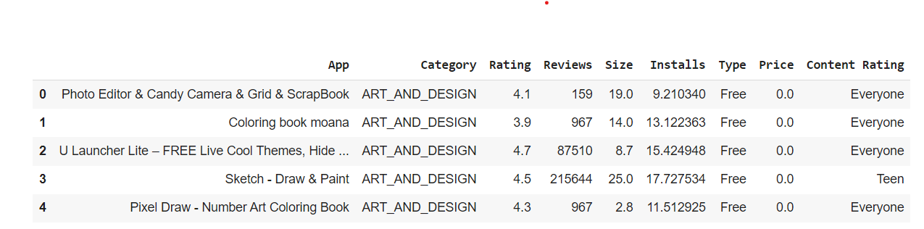
DATA CLEANING & OUTLIERS
There were plenty of missing data from the numerical as well as the categorical features which were imputed using the mean and the mode of the features respectively.
Outliers consisted of negative ratings which can’t exist as well as infinity values of the target variable after using the natural logarithm to standardize the observations.
We dropped the negative rating rows as this was an obvious data acquisition error.
We kept the infinite value rows, replacing the infinite values with the mean of the series as these provided considerable insight and was clearly a computational error.

Slide 5
DATA EXPLORATION
Family, Game, and Tools categories dominate the app market in terms of volume.
Medical, Family, Business, and Photography categories have the highest app prices (after excluding junk apps from the dataset).
Free apps have more popularity amongst users though these might not have the same high user retention as paid apps in the long run.
Cheaper and smaller apps (under 20MB and under $10) tend to have higher growth from the time of the app launch.
Content rated to be for teens and everyone aged 10+ seem to have the most popularity amongst user. Although mature 17+ rated apps also perform well provided that they are free apps.
Gaming and Photography apps perform the best in terms of user retention. Social Media apps present high retention numbers as well.
Though most metrics point toward labelling an app ‘free’ as the primary strategy, sentiment polarity shows paid apps have better user satisfaction, hence, offer better user retention and growth (especially if it’s a subscription based app).

Slide 6
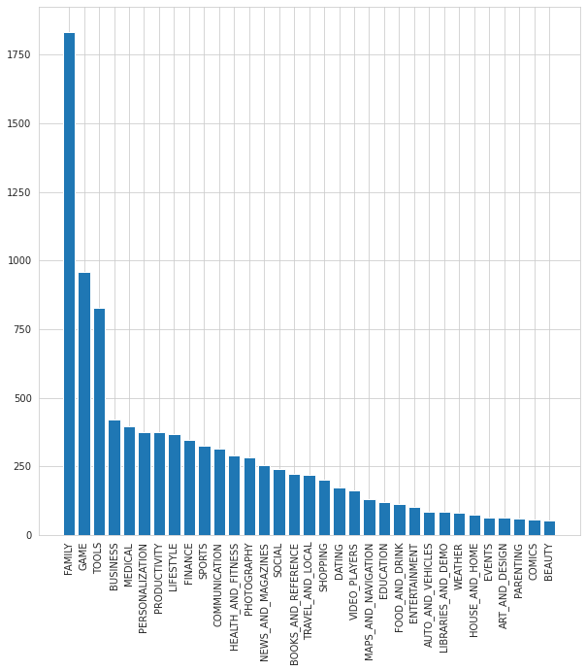
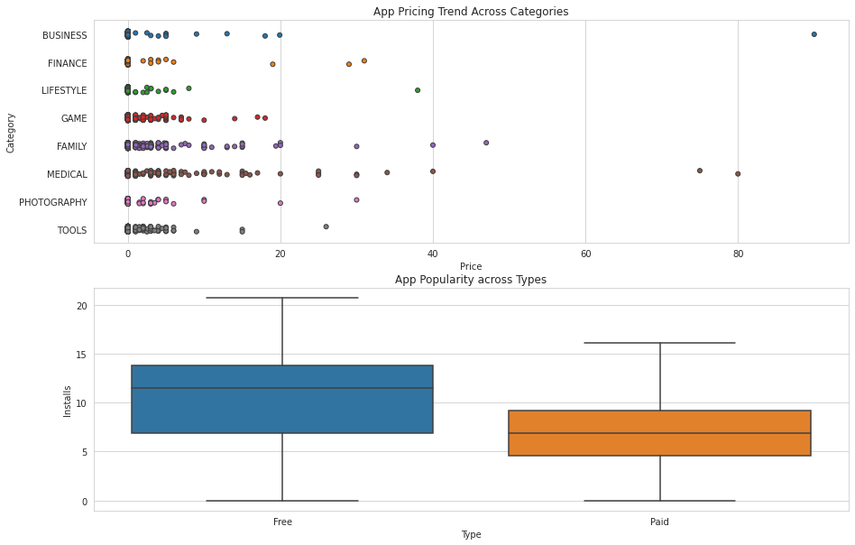
2.
1.
3.

Slide 7
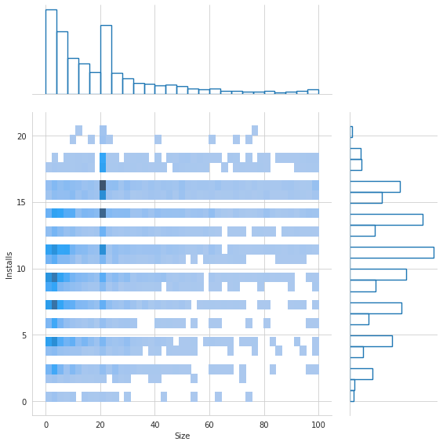
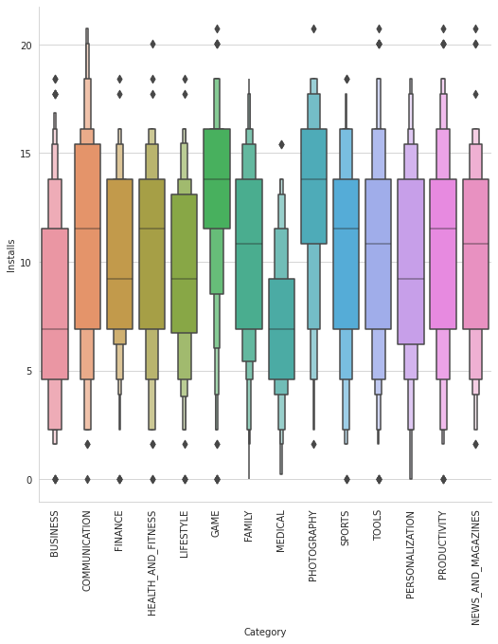
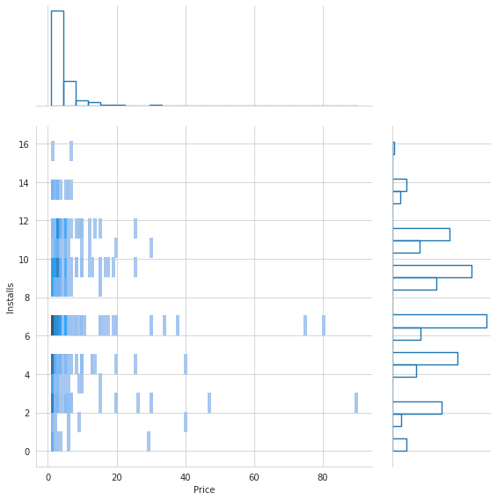
4.
6.

Slide 8
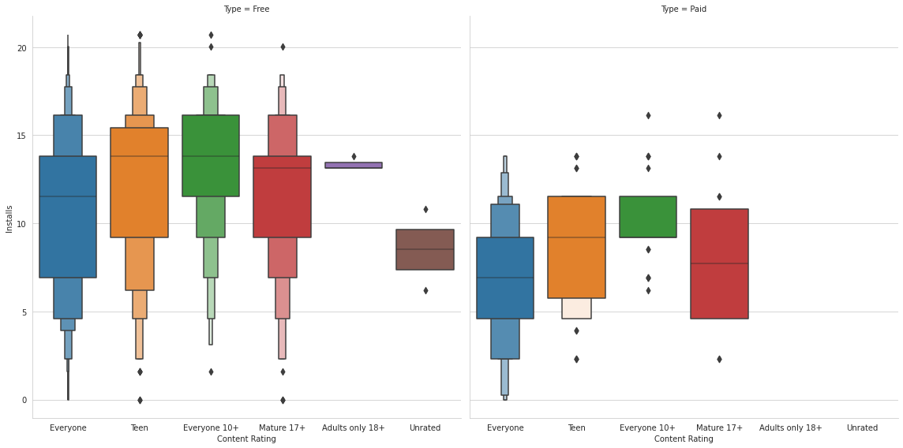
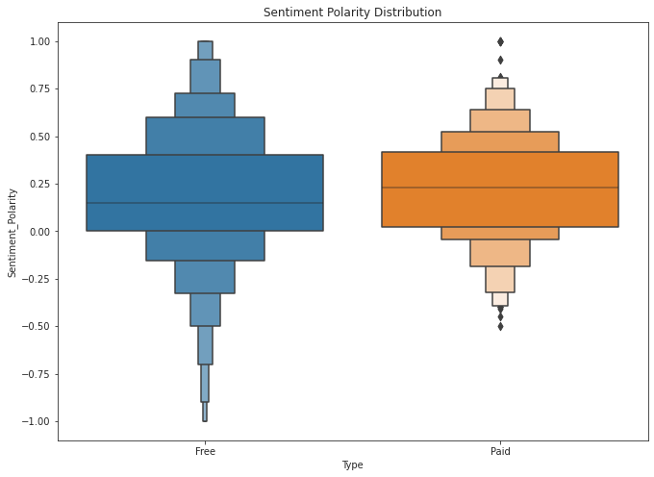
5.
7.

Slide 9
MODEL SELECTION
We used two models – Random Forest and Gradient Boosting Regressors.
To prepare the final dataset, we merged both the reviews and apps datasets and imputed the missing values.
We then cross validated both models and selected the one with the higher R² score.
The CV scores were plotted in a boxplot for comparison purposes.
Hyperparameters were tuned by hand.

Slide 10
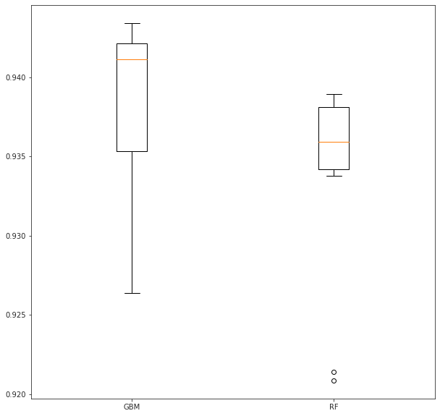
EVALUATION METRICS
Accuracy of the model/ R²: 0.938 or 93.8%

Slide 11
SUGGESTIONS
Based on the insights collected from the EDA, app developers should look to provide the following types of apps:
Smaller sized apps (under 10MB preferably)
Free apps (if growth is the main target and advertisements are the main sources of earning)
Paid apps priced mostly under $10 (if retention is the primary metric of concern
Higher priced apps are the norm in medical and photography categories, don’t shy away from providing a competitively cheaper price.
Should aim for less popular categories to help with lesser competition, although a lack of reach and attention would be a genuine risk to the app
Open content apps as restrictive content apps won’t perform as well

Slide 12
CONCLUSIONS
Further steps would include improving upon the predictive model by increasing the number of models tested to choose a better regressor.
Could also include polynomial features and other features not present in the dataset such as Daily/Weekly usage to indicate retention in a better manner perhaps.
Could also improve upon the model by using GridSearchCV and/or other algorithms instead of tuning hyperparameters by hand.
Searching for/Extracting a larger dataset for better all-round analysis and predictive power to indicate initial growth via no. of expected installations.

